Slide 1



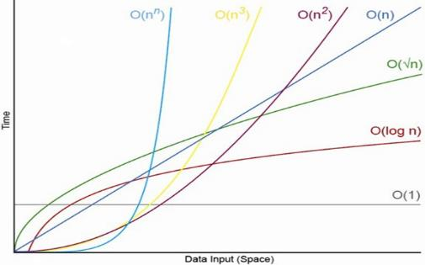
Algorithm Complexity, Linear Data Structures
O(n)
Analyzing Algorithm Complexity, Asymptotic Notation
Data
Structures
SoftUni Team
Technical Trainers
Software University
http://softuni.bg

Slide 2

Table of Contents
Complexity of Algorithms
Algorithm Count of Operations
Best, Average and Worst Case
Asymptotic Notation – O(g)
Linear Data Structures
Arrays
Dynamic Arrays
O(n)

Slide 3
Have a Question?
sli.do #DsAlgo

Slide 4

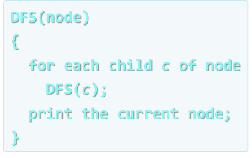
Algorithm Complexity
Asymptotic Notation

Slide 5



Algorithm Analysis
Why should we analyze algorithms?
Predict the resources the algorithm will need
Computational time (CPU consumption)
Memory space (RAM consumption)
Communication bandwidth consumption
Hard disk operations

Slide 6
Algorithm Analysis (2)
The expected running time of an algorithm is:
The total number of primitive operations executed (machine independent steps)
Also known as algorithm complexity
Compare algorithms ignoring details such as
language or hardware

Slide 7
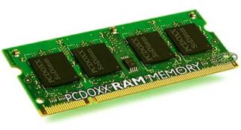
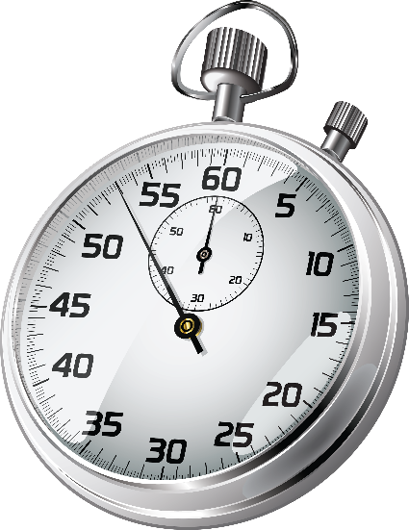
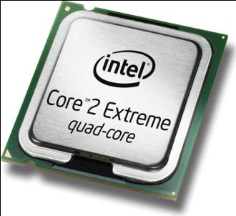
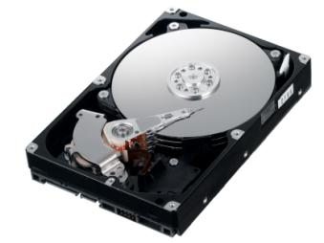
Algorithmic Complexity
What to measure?
CPU time
Memory consumption
Number of steps
Number of particular operations
Number of disk operations
Number of network packets
Asymptotic complexity

Slide 8
Problem: Get Sum Number of Steps
Calculate maximum steps to find sum of even elements in an array
Assume that a single step is a single CPU instruction:
assignments, array lookups, comparisons, arithmetic operations
Solution:
T(n) = 9n + 3
int GetSumEven(int[] array)
{
int sum = 0;
for (int i = 0; i < array.Length; i++)
if (array[i] % 2 == 0) sum += array[i];
return sum;
}
Counting maximum steps is called worst-case analysis

Slide 9
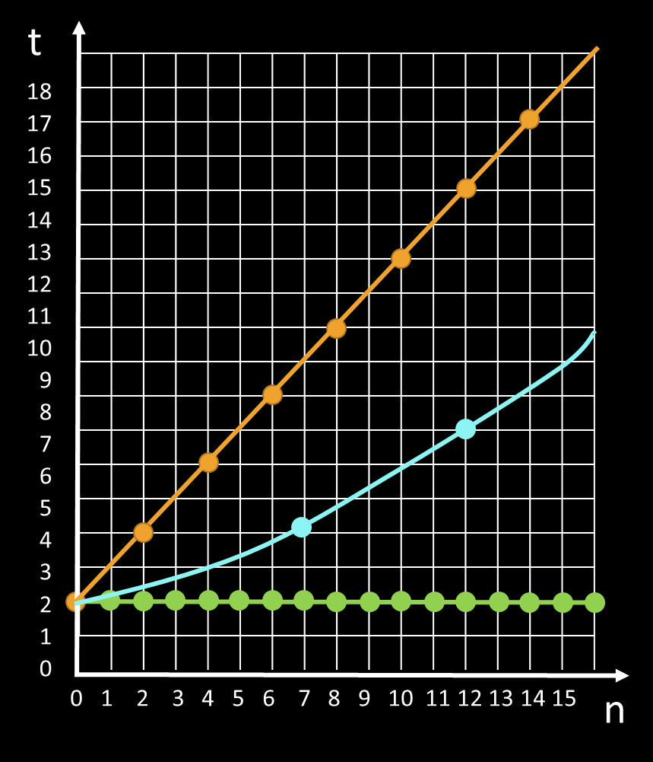
Time Complexity
Worst-case
An upper bound on the running time
Average-case
Average running time
Best-case
The lower bound on the running time (the optimal case)

Slide 10
Problem: Contains Number of Steps
Calculate maximum steps to find if an element is in an array
Assume that a single step is a single CPU instruction like:
assignments, array lookups, comparisons, arithmetic operations
Solution:
T(n) = 4n + 4
int Contains(int[] array, int element)
{
for (int i = 0; i < array.Length; i++)
if (array[i] == element) return true;
return false;
}

Slide 11
Simplifying Step Count
Some parts of the equation grow much faster than others
Higher terms dominate lower terms – n > 2, n² > n, n³ > n²
Multiplicative constants can be omitted – 12n → n, 2n² → n²
n = 1000
steps: 4000 + 4
int Contains(int[] array, int element)
{
for (int i = 0; i < array.Length; i++)
if (array[i] == element) return true;
return false;
}
Relevant part: n

Slide 12
Problem: Fibonacci Number of Steps
Calculate steps to find n^{th} Fibonacci number recursively
but F_{n} = F_{n – 1} + F_{n – 2} which is ≤ T(n)
but, for example F₄₀ = 102,334,155!
Solution:
T(n) = 3 + T(n - 1) + T(n - 2)
int Fibonacci(int n)
{
if (n == 0) return 1;
else if (n == 1) return 1;
else return Fibonacci(n-1) + Fibonacci(n-2);
}
Steps: 2^{0.694n} ≈ (1.6)^{n}

Slide 13
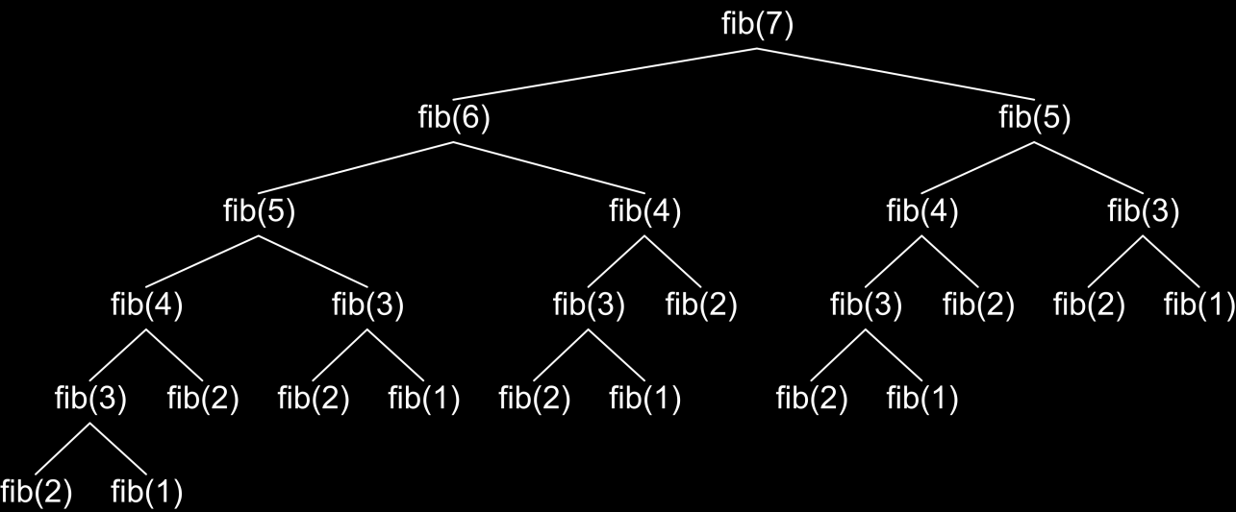
Fibonacci Recursion Tree
fib(n) makes about fib(n) recursive calls
The same value is calculated many, many times!

Slide 14
Algorithms Complexity
Algorithm complexity – rough estimation of the number of steps performed by given computation, depending on the size of the input
Measured with asymptotic notation
O(f(n)) – read "Big oh of f(n)"
Θ(f(n)) – read "Theta of f(n)"
Ω(f(n)) – read "Omega of f(n)"
where f(n) is a function of the size of the input data

Slide 15
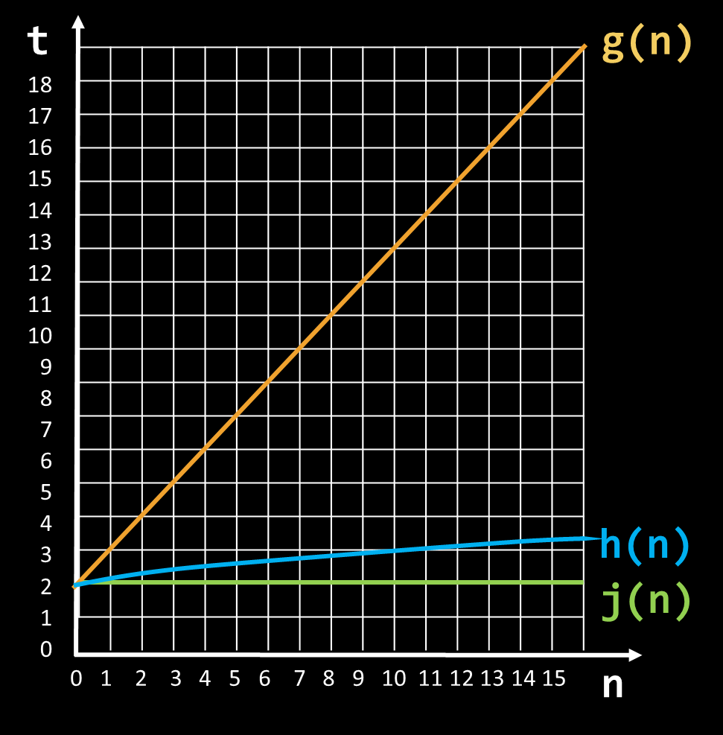
Asymptotic Notations
O(f(n)) – Upper bound
j = O(g)
j = O(h)
Θ(f(n)) – Upper & Lower bound
j = Θ(j)
g = Θ(g)
Ω(f(n)) – Lower bound
h = Ω(j)
g = Ω(j)

Slide 16
Asymptotic Notation: Definition
For a given function g(n), we denote by O(g(n)) the set of functions that are different than g(n) by a constant
Examples:
2 * n² + 10 ∈ O(n²)
10n + 4 ∈ O(n)
4*n*log₂(3*n+1) + 2*n-1 ∈ O(n * log n)
O(g(n)) = {f(n): there exist positive constants c and n₀ such that f(n) <= c*g(n) for all n >= n₀}

Slide 17
Functions Growth Rate
ƒ(n)
О(n) means a function grows linearly when n increases
E.g.
O(n²) means a function grows exponentially when n increases
E.g.
O(1) means a function does not grow when n changes
E.g.
18
17
16
15
14
13
12
11
10
9
8
7
6
5
4
3
2
1
0
ƒ(n)=n+1
ƒ(n)=n²+2n+2
ƒ(n)=4
0 1 2 3 4 5 6 7 8 9 10 11 12 13 14 15
n

Slide 18
Asymptotic Functions

Slide 19
Typical Complexities
Complexity | Notation | Description
constant | O(1) | n = 1 000 → 1-2 operations
logarithmic | O(log n) | n = 1 000 → 10 operations
linear | O(n) | n = 1 000 → 1 000 operations
linearithmic | O(n*log n) | n = 1 000 → 10 000 operations
quadratic | O(n²) | n = 1 000 → 1 000 000 operations
cubic | O(n³) | n = 1 000 → 1 000 000 000 operations
exponential | O(n^{n}) | n = 10 → 10 000 000 000 operations

Slide 20
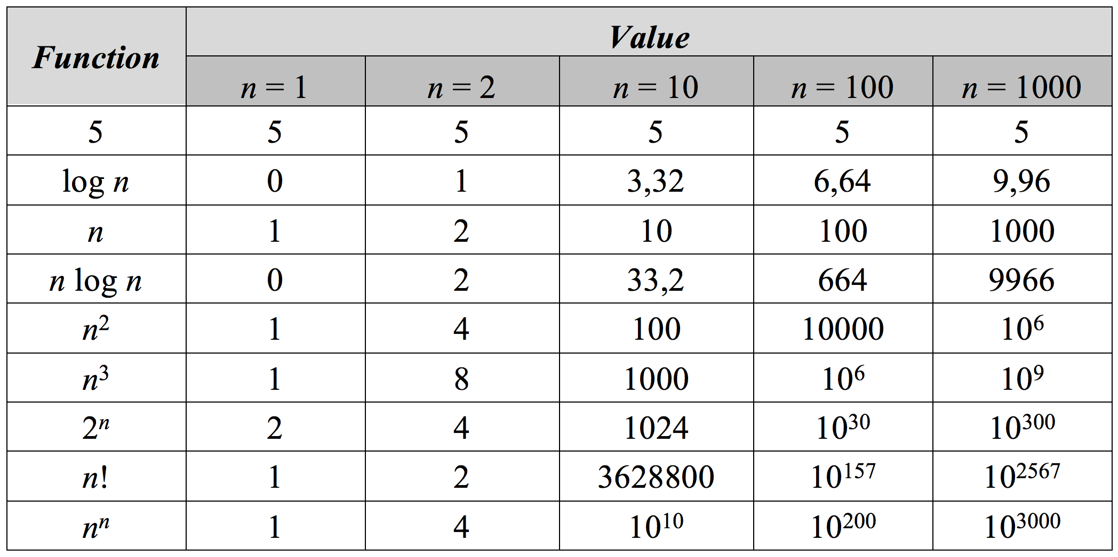
Function Values

Slide 21
Time Complexity and Program Speed
Complexity | 10 | 20 | 50 | 100 | 1 000 | 10 000 | 100 000
O(1) | < 1 s | < 1 s | < 1 s | < 1 s | < 1 s | < 1 s | < 1 s
O(log(n)) | < 1 s | < 1 s | < 1 s | < 1 s | < 1 s | < 1 s | < 1 s
O(n) | < 1 s | < 1 s | < 1 s | < 1 s | < 1 s | < 1 s | < 1 s
O(n*log(n)) | < 1 s | < 1 s | < 1 s | < 1 s | < 1 s | < 1 s | < 1 s
O(n²) | < 1 s | < 1 s | < 1 s | < 1 s | < 1 s | 2 s | 3-4 min
O(n³) | < 1 s | < 1 s | < 1 s | < 1 s | 20 s | 5 hours | 231 days
O(2^{n}) | < 1 s | < 1 s | 260 days | hangs | hangs | hangs | hangs
O(n!) | < 1 s | hangs | hangs | hangs | hangs | hangs | hangs
O(n^{n}) | 3-4 min | hangs | hangs | hangs | hangs | hangs | hangs

Slide 22
Memory Requirement
Memory consumption should also be considered, for example:
Storing elements in a matrix of size N
Filling the matrix – Running time O(n²)
Get element by index – Running time O(1)
Memory requirement O(n²)

Slide 23

Linear Data Structures
Arrays, Resizable Lists, Linked Lists

Slide 24
Abstract Data Types (ADT)
An Abstract Data Type (ADT) is
A data type together with the operations, whose properties are specified independently of any particular implementation
ADT can have several different implementations
Example:
List – variable sized, ordered sequence of elements that supports
Add, Get, Set, Remove
Can be implemented using an array, or a list of linked nodes

Slide 25
What is a Data Structure?
“In computer science, a data structure is a particular way of storing and organizing data in a computer so that it can be used efficiently.”
-- Wikipedia
Examples of data structures:
Person structure (first name + last name + age)
Array of integers – int[]
List of strings – List<string>
Queue of people – Queue<Person>

Slide 26
Array Data Structures
 |  | 2 | 4 | 1 | 3 | 5
Built-in and Lightweight

Slide 27
Array Data Structure
Ordered
Very lightweight
Has a fixed size
Usually built into the language
Many collections are implemented by using arrays, e.g.
List<T> in .NET
ArrayList<T> in Java

Slide 28
Why Arrays Are Fast?
Arrays use a single block of memory
Uses total of array pointer + (N * element/pointer size)
Array Address + (Element Index * Size) = Element Address
Array Element Lookup – O(1)
Int32 uses 4 bytes
int[] array = { 2, 4, 1, 3, 5 };
 |  | 2 | 4 | 1 | 3 | 5
Total: 5 * 4 bytes
Array starts at this address

Slide 29
Arrays – Changing Array Size
Arrays have a fixed size
Memory after the array may be occupied
If we want to resize the array we have to make a copy
Array Copy – O(n)
Free for garbage collection
 |  | 2 | 4 | 1 | 3 | 5
2 | 4 | 1 | 3 | 5 | 0 | 0 | 0
 |  | 2 | 4 | 1 | 3 | 5
May be occupied

Slide 30
List Data Structure
 |  | 2 | 4 | 1 | 3 | 5
Resizing Arrays

Slide 31
Dynamic Arrays (Lists)
Has a variable size
Implemented using an array
List
New array with copied elements
Add
2 | 4 | 1 | 3 | 5
2 | 4 | 1 | 3 | 5 | 1
Remove
Count = 5
Count = 6
Add
Get
Set
Remove
O(n)
O(1)
O(1)
O(n)

Slide 32
Dynamic Arrays (Lists) – Add O(1)
Doubles its capacity when needed
Copying occurs at log(n) → n = 10⁹, only ~30 copies
List
2
2 | 4
2 | 4 | 1
Capacity = 2
Capacity = 2
Capacity = 4
Count = 1
Count = 2
Count = 3
Add
Add
O(1)
O(n)
Amortized O(1)

Slide 33
Problem: ArrayList
Create an ArrayList<T> data structure, which supports
Count
Indexer[] – get and set
void Add(T) – O(1)
T RemoveAt(int) – O(n) throws IndexOutOfRange
Double array if count == capacity
Shrink array if count <= capacity / 4
Same name, without namespace

Slide 34
Solution: ArrayList
public class ArrayList<T> : IEnumerable<T>
{
private T[] items;
public int Count { get; private set; }
public T this[int index] {}
public void Add(T item) {}
public T Get(int index) {}
public void Set(int index, T item) {}
public T RemoveAt(int index) {}
}

Slide 35
Solution: ArrayList
Add:
if (Count == Capacity)
Resize (Capacity * 2)
add item at index Count
increment Count
Get:
check if index is valid
return the item at index

Slide 36
Solution: ArrayList (2)
Set:
check if index is valid
set the item at index
Remove:
check if index is valid
remove item (Make sure to clean reference)
shift remaining elements left
decrement count
if (Count == Capacity / 4)
shrink Array (halve Capacity)

Slide 37

Linear Data Structures
Live Exercises in Class (Lab)

Slide 38
Summary
Algorithm complexity is a rough estimation of the number of steps performed by given computation
Data structures organize data in computer systems for efficient use
Abstract data types (ADT) describe a set of operations
Arrays are a lightweight data structure that has constant time access to elements but has a fixed size
Lists are a variable size data structures

Slide 39









Algorithm Complexity and Linear Data Structures
https://softuni.bg/courses/programming-fundamentals

Slide 40
License
This course (slides, examples, labs, videos, homework, etc.) is licensed under the "Creative Commons Attribution-NonCommercial-ShareAlike 4.0 International" license
Attribution: this work may contain portions from
"Fundamentals of Computer Programming with C#" book by Svetlin Nakov & Co. under CC-BY-SA license
"Data Structures and Algorithms" course by Telerik Academy under CC-BY-NC-SA license

Slide 41






Free Trainings @ Software University
Software University Foundation – softuni.org
Software University – High-Quality Education, Profession and Job for Software Developers
softuni.bg
Software University @ Facebook
facebook.com/SoftwareUniversity
Software University @ YouTube
youtube.com/SoftwareUniversity
Software University Forums – forum.softuni.bg

